Slide 1





Agriculture raw material Analysis
Name: VINOTHKUMAR B Guide: P.Raja,Master Trainer
NM-ID: aut923821114307
E-Mail ID:vk1951999@gmail.com
Disclaimer: The content is curated for educational purposes only.
Notes:
Slides: Prepare a short slide deck (10-12 slides) summarizing the project objectives, methodology, and key results.

Slide 2
OUTLINE
Abstract of the Project
Problem Statement
Proposed Solution
System Architecture
Live Demo of the Project
Embedded Video of Project
Conclusion
Future Scope

Slide 3
Abstract
This study performs an exploratory data analysis (EDA) on agricultural raw material prices over time, focusing on key insights such as price volatility, percentage changes, and the relationships between various commodities. It identifies the high and low price ranges for each raw material and calculates the materials with the highest and lowest percentage price fluctuations. The analysis tracks how price ranges evolve over the years, providing a clear view of market trends. A correlation heatmap is used to explore how the price trends of different raw materials are interrelated. The findings offer valuable insights into market dynamics, informing both strategic decisions and policy formulations in the agricultural sector.

Slide 4
Problem Statement
This study analyzes agricultural raw material prices over time to identify key trends, price volatility, and interdependencies among different commodities. By performing an Exploratory Data Analysis (EDA), it aims to uncover patterns in price fluctuations and their causes. The findings will provide insights to inform market strategies and policy decisions in the agricultural sector.

Slide 5
Proposed Solution
The proposed solution involves analyzing agricultural raw material prices using Exploratory Data Analysis (EDA) to identify price ranges, percentage changes, and fluctuations over time. Correlations between different raw materials will be mapped using a heatmap. This will provide valuable insights to support data-driven market strategies and policy decisions.

Slide 6
System Architecture
The system architecture consists of data collection from agricultural price datasets, followed by data preprocessing and cleaning. An analytical engine performs Exploratory Data Analysis (EDA) to identify trends, price volatility, and correlations, with visualizations generated through Python libraries like Matplotlib and Seaborn. The insights are then presented through interactive dashboards or reports for decision-making.

Slide 7
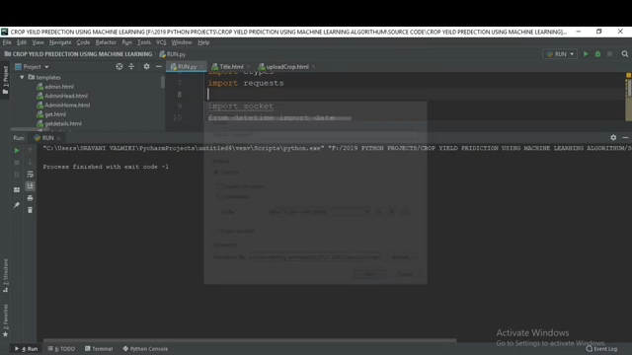
Video of Project Demo

Slide 8
Conclusion
In conclusion, the analysis reveals key insights into price trends, volatility, and correlations among agricultural raw materials. These findings provide valuable information for optimizing market strategies and risk management. Ultimately, the study supports informed decision-making in the agricultural sector.

Slide 9
Future Scope
The future scope of this analysis includes expanding the dataset to incorporate additional agricultural commodities, geographic regions, and external factors like weather patterns or trade policies. Advanced machine learning models can be employed to predict price trends and volatility, enhancing forecasting accuracy. Furthermore, real-time data integration and interactive dashboards could provide continuous insights, helping stakeholders respond dynamically to market changes.

Slide 10
Thank you!
Notes:
thank you very much for joining this PPT, keep learning.
10

